Slide 1
Multithreading
Rajasekaran S
Assistant Professor,
Department of Information Technology,
KGiSL Institute of Technology,
email: proffraja@gmail.com
Github:www.github.com/rajasekaranap

Slide 2
Types of System
Single Processing.
It can run one program at a time.
Other programs must wait until CPU is released.
Multiprocessing
More than one CPU available.
It can run programs parallel.
It saves time in mutilcore processors.

Slide 3
Types of System
Single programming.
It can load and execute single program in a memory.
Other program even waits to load into memory.
Multiprogramming.
It can load more than one program into different parts of memory.
If one process waits for I/O then context switch is performed and other process is executed.

Slide 4
Types of Systems
Multitasking
Each program can have n number of task’s.
Similar to multi programming but a part of a program [task] get executed instead of whole program.
Single CPU performs multiple task based of context switching .
Task is sub unit for whole program can be compared to single thread.

Slide 5
Types of Systems
Multithreading.
It takes the advantage of multi processor systems.
A single process is executed in multiple cores in a single context.
Part’s of a program can execute concurrently in multiple cores.
Multiple Programs -> Multitasking - > Multicores

Slide 6
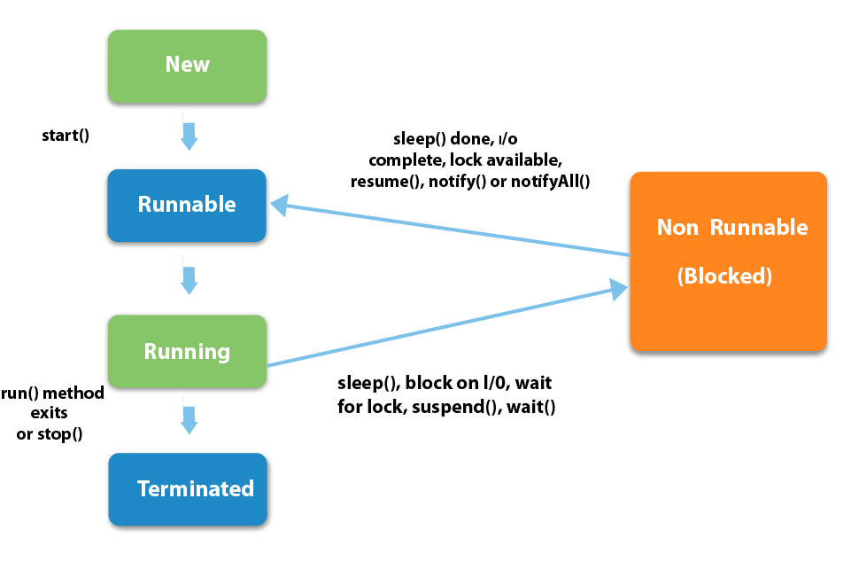
Life Cycle of Threads
Wait

Slide 7
Sates of Thread
New
The thread is in new state if you create an instance of Thread class but before the invocation of start() method.
Runnable
The thread is in runnable state after invocation of start() method, but the thread scheduler has not selected it to be the running thread.

Slide 8
Sates of Thread
Running
The thread is in running state if the thread scheduler has selected it.
Non-Runnable/Blocked/Waiting
This is the state when the thread is still alive, but is currently not eligible to run.
Terminated
A thread is in terminated or dead state when its run() method exits.
It is no longer available to execute.

Slide 9
Creating Threads in Java
A class must extend form Thread.
Override run() method of Thread class.
Create an instance for user thread class .
Call the start method to invoke the thread.
LifeCycle Methods
void start()
void run()
void wait()
void stop()

Slide 10
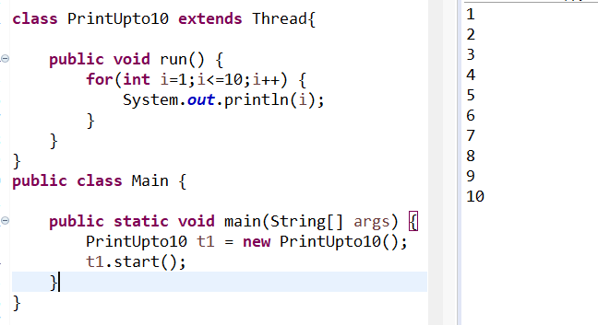
Simple Thread That Prints upto 10

Slide 11
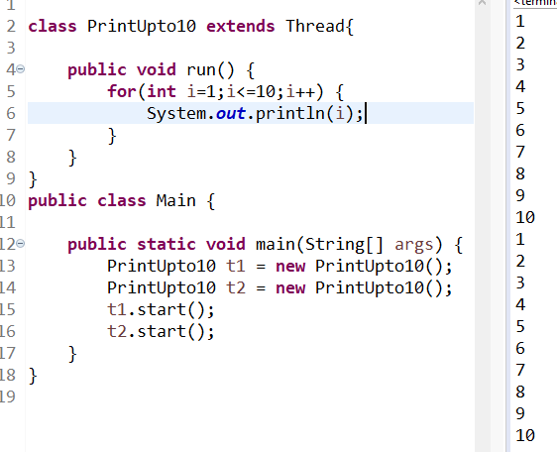
Invoking two threads

Slide 12
Thank You
Rajasekaran S
Assistant Professor,
Department of Information Technology,
KGiSL Institute of Technology,
email: proffraja@gmail.com
Github:www.github.com/rajasekaranap

